Slide 1
Module 3
IPC

Slide 2
Interprocess Communication
Processes within a system may be
independent or
cooperating

Slide 3
Interprocess Communication
Independent Process-
If it cannot affect or be affected by other processes executing in the system
Any process that does not share any data with any other process
Cooperating process-
can affect or be affected by other processes,
Any process that shares data with other process

Slide 4
Interprocess Communication
Reasons for cooperating processes:
Information sharing
Since several users may be interested in the same piece of information (for instance, a shared file),
we must provide an environment to allow concurrent access to such information.

Slide 5
Interprocess Communication
Reasons for cooperating processes:
Computation speedup
If we want a particular task to run faster,
we must break it into subtasks,
each of which will be executing in parallel with the others.
A speedup can be achieved only if
the computer has multiple processing elements (such as CPUs or I/O channels).

Slide 6
Interprocess Communication
Reasons for cooperating processes:
Modularity
We may want to construct the system in a modular fashion,
dividing the system functions into separate processes or threads,
Convenience
Even an individual user may work on many tasks at the same time.
For instance, a user may be editing, printing, and compiling in parallel.

Slide 7
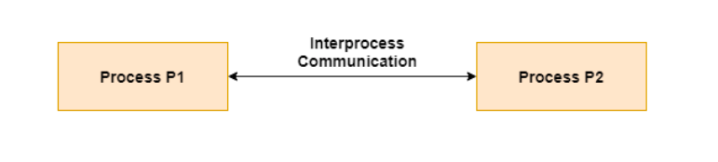
Interprocess Communication
Cooperating processes need interprocess communication (IPC) mechanism to exchange data and information

Slide 8
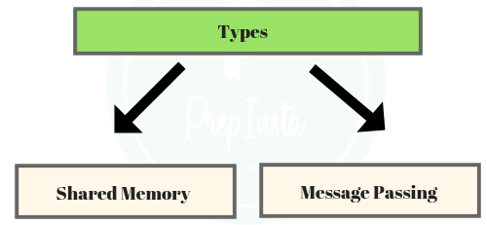
Interprocess Communication
Two models of IPC
Shared memory
Message passing

Slide 9
Interprocess Communication
In the shared-memory model,
A region of memory that is shared by cooperating processes is established.
Processes can then exchange information by reading and writing data to the shared region.
In the message passing model,
communication takes place by means of messages exchanged between the cooperating processes.

Slide 10
Communications Models
(a) Message passing. (b) shared memory.

Slide 11
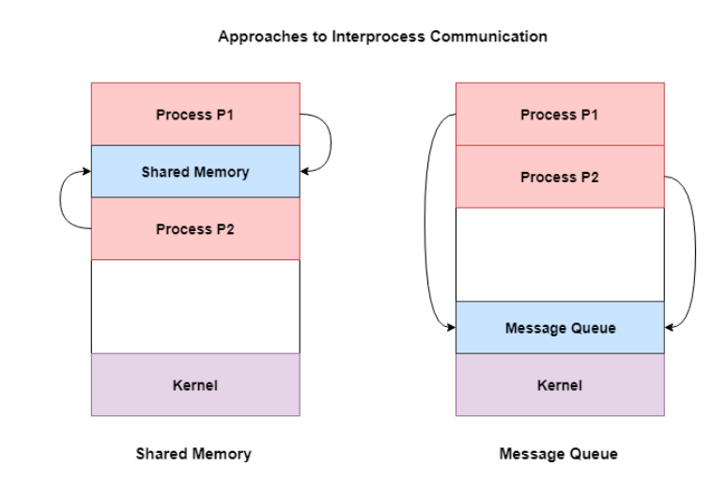
Communications Models

Slide 12
Message Passing
Shared memory
Message passing is useful for
exchanging smaller amounts of data,
because no conflicts need be avoided.
Message passing is also easier to implement than
shared memory for interprocess communication.
Shared memory allows
maximum speed and convenience of communication
Shared memory is faster
than message passing.

Slide 13
Message Passing
Shared memory
Slower As message passing systems are typically implemented
using system calls and
thus require the more time-consuming task of kernel intervention.
Faster as In shared memory systems,
system calls are required only to establish shared-memory regions.
Once shared memory is established, all accesses are treated as routine memory accesses,
and no assistance from the kernel is required.

Slide 14
Producer-Consumer Problem
Paradigm for cooperating processes,
A producer process
produces information
that is consumed by a consumer process.

Slide 15
Producer-Consumer Problem
For example,
A compiler may produce assembly code,
which is consumed by an assembler.
The assembler, in turn, can produce object modules,
which are consumed by the linker.
Server as a producer and a client as consumer.
For example, a Web server produces (that is, provides) HTML files and images,
which are consumed (that is, read) by the client Web browser requesting the resource.

Slide 16
Producer-Consumer Problem
Solution= Shared memory.
To allow producer and consumer processes to run concurrently,

Slide 17
Producer-Consumer Problem
An available buffer of items that
can be filled by the producer and
emptied by the consumer.
This buffer will reside in a region of memory
that is shared by the producer and consumer processes.(Shared Memory)

Slide 18
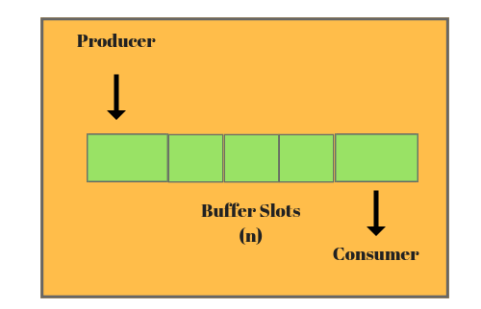
Producer-Consumer Problem
A producer can produce one item
While the consumer is consuming another item.

Slide 19
Producer-Consumer Problem
The producer and consumer must be synchronized,
so that the consumer does not try to consume an item
that has not yet been produced.

Slide 20
Producer-Consumer Problem
Two types of buffers can be used.
unbounded-buffer
bounded-buffer

Slide 21
Producer-Consumer Problem
Two types of buffers can be used.
unbounded-buffer places no practical limit on the size of the buffer
The consumer may have to wait for new items,
but the producer can always produce new items.
bounded-buffer assumes that there is a fixed buffer size
The consumer must wait if the buffer is empty,
and the producer must wait if the buffer is full.

Slide 22
Bounded-Buffer – Shared-Memory Solution
Shared data
The following variables reside in a region of memory shared by the producer and consumer processes:
#define BUFFER_SIZE 10
typedef struct {
. . .
} item;
item buffer[BUFFER_SIZE];
int in = -1;
int out = -1;

Slide 23
Bounded-Buffer – Shared-Memory Solution
The shared buffer is implemented as a circular array
with two logical pointers: in and out.
#define BUFFER_SIZE 10
typedef struct {
. . .
} item;
item buffer[BUFFER_SIZE];
int in = -1;
int out = -1;

Slide 24
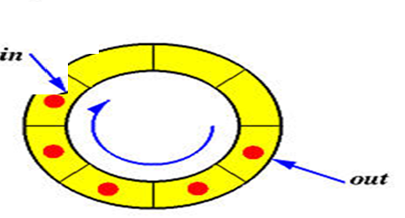
Bounded-Buffer – Shared-Memory Solution
in points to the last element in the buffer;
out points to the first full position/first element in the buffer.

Slide 25
Bounded-Buffer – Shared-Memory Solution
The buffer is empty when in== out=-1;

Slide 26
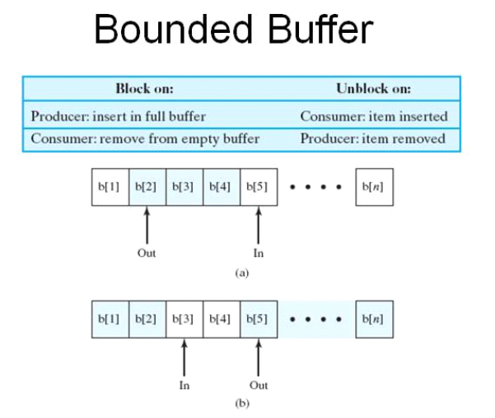
Bounded-Buffer – Shared-Memory Solution
The buffer is full when
((in+ 1)% BUFFER_SIZE== out || out==0 && in==BUFFER_SIZE-1) )
//if((front == 0 && rear == MAX-1) || (front == rear+1))

Slide 27
Bounded-Buffer – Producer
The producer process has a local variable nextProduced
in which the new item to be produced is stored.
item next_produced;
while (true) {
/* produce an item in next produced */
while (((in + 1) % BUFFER_SIZE == out || out==0 && in==BUFFER_SIZE-1) == out); /* do nothing */
buffer[in] = next_produced;
in = (in + 1) % BUFFER_SIZE;
}

Slide 28
Bounded Buffer – Consumer
The consumer process has a
local variable next Consumed in which the item to be consumed is stored.
item next_consumed;
while (true) { while (in == out==-1) ; /* do nothing */ next_consumed = buffer[out];
out = (out + 1) % BUFFER_SIZE;
/* consume the item in next consumed */
}

Slide 29
Interprocess Communication – Shared Memory
What ?
An area of memory shared among the processes that wish to communicate

Slide 30
Interprocess Communication – Shared Memory
The communication is under the control of the
users processes not the operating system.
The code for accessing and manipulating the shared memory be written
explicitly by the application programmer.

Slide 31
Interprocess Communication – Shared Memory
Major issues is to provide mechanism that will allow the user processes to
synchronize their actions when they access shared memory.

Slide 32
Interprocess Communication – Message Passing

Slide 33
Interprocess Communication – Message Passing
Another means for cooperating processes to communicate with each other
via a message-passing facility.
Processes communicate with each other
without resorting to shared variables or shared address space

Slide 34
Interprocess Communication – Message Passing
Mechanism needed for processes
to communicate and
to synchronize their actions

Slide 35
Interprocess Communication – Message Passing
Why?

Slide 36
Interprocess Communication – Message Passing
Particularly useful in a distributed environment,
where the communicating processes may reside on different computers
connected by a network.
For example, a chat program used on the World Wide Web could be designed so
that chat participants communicate with one another by exchanging messages.

Slide 37
Interprocess Communication – Message Passing
IPC facility provides two operations:
send(message)
receive(message)
The message size is either
fixed or
variable

Slide 38
Interprocess Communication – Message Passing
If only fixed-sized messages can be sent,
the system-level implementation is straightforward.
the task of programming more difficult.
Conversely, variable-sized messages require
a more complex system-level implementation,
but the programming task becomes simpler.

Slide 39
Message Passing (Cont.)
If processes P and Q wish to communicate, they need to:
Establish a communication link between them
Exchange messages via send/receive

Slide 40
Message Passing (Cont.)
Implementation issues:
How are links established?
Can a link be associated with more than two processes?
How many links can there be between every pair of communicating processes?
What is the capacity of a link?
Is the size of a message that the link can accommodate fixed or variable?
Is a link unidirectional or bi-directional?

Slide 41
Message Passing (Cont.)
Implementation issues:
A link has some capacity that determines the number of messages that can reside in it temporarily
for which every link has a queue associated with it

Slide 42
Message Passing (Cont.)
Implementation of communication link
Physical:
Shared memory
Hardware bus
Network
Logical:
Direct or indirect
Synchronous or asynchronous
Automatic or explicit buffering

Slide 43
Message Passing (Cont.)
Processes that want to communicate must have a way to refer to each other.
They can use either
direct or
indirect communication.

Slide 44
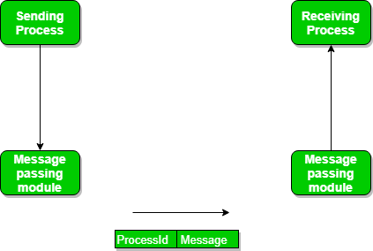
Direct Communication
Processes must name each other explicitly:
send (P, message) – send a message to process P
receive(Q, message) – receive a message from process Q

Slide 45
Direct Communication
Properties of communication link
Links are established automatically between every pair of processes that want to communicate.
The processes need to know only each other's identity to communicate.
A link is associated with exactly one pair of communicating processes
Between each pair there exists exactly one link
The link may be unidirectional, but is usually bi-directional

Slide 46
Direct Communication
This scheme exhibits symmetry in addressing; that is,
both the sender process and the receiver process must name the other to communicate.

Slide 47
Direct Communication- A variant
A variant of this scheme employs asymmetry in addressing.
Only the sender names the recipient;
the recipient is not required to name the sender.

Slide 48
A variant
In this scheme, the send() and receive() primitives are defined as follows:
send(P, message) -Send a message to process P.
receive (id, message) -Receive a message from any process;
the variable id is set to the name of the process with which communication has taken place.

Slide 49
Disadvantage in symmetric and asymmetric schemes
Limited modularity of the resulting process definitions.
Changing the identifier of a process may necessitate examining all other process definitions.
All references to the old identifier must be found, so that they can be modified to the new identifier.
Any such hard-coding techniques, where identifiers must be explicitly stated, are less desirable than techniques involving indirection.

Slide 50
Indirect Communication
Messages are directed and received from mailboxes (also referred to as ports)
Each mailbox has a unique id
Processes can communicate only if they share a mailbox

Slide 51
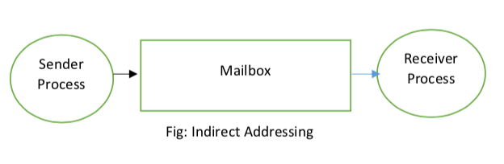
Indirect Communication
A mailbox can be viewed abstractly as an
object into which messages can be placed by processes and
from which messages can be removed.
Each mailbox has a unique identification

Slide 52
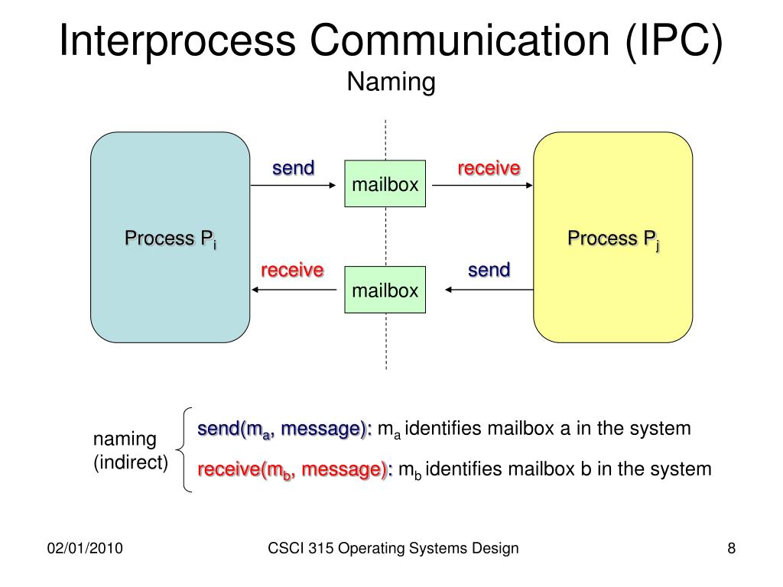
Indirect Communication-mailboxes
A process can communicate with some other process via a number of different mailboxes.
Two processes can communicate only if the processes have a shared mailbox,

Slide 53
Indirect Communication
Properties of communication link
Link established only if processes share a common mailbox
A link may be associated with many processes
Between Each pair of communicating processes, there may be a number of different links with each link corresponding to one mailbox
Link may be unidirectional or bi-directional

Slide 54
Indirect Communication
Primitives are defined as:
send(A, message) – send a message to mailbox A
receive(A, message) – receive a message from mailbox A

Slide 55
Indirect Communication
Mailbox sharing
P₁, P₂, and P₃ share mailbox A
P₁, sends message to A;
P₂ and P₃ execute receive from A
Who gets the message?

Slide 56
Indirect Communication
Solutions
The answer depends on which of the following methods we choose:
This can be solved by either
Enforcing that only two processes can share a single mailbox
or
Allow only one process at a time to execute a receive operation
That is, either P2 or P3, but not both, will receive the message
or
Allow the system to select arbitrarily the receiver
The system also may define an algorithm for selecting which process will receive the message
that is, round robin, where processes take turns receiving messages
Sender is notified about the receiver.

Slide 57
Who owns the Mailbox??

Slide 58
A mailbox may be owned either
by a process or
by the operating system.

Slide 59
If the mailbox is owned by a process
Mailbox is part of the address space of the process
The owner can only receive messages through this mailbox
The user can only send messages to the mailbox
Since each mailbox has a unique owner,
there can be no confusion about which process should receive a message sent to this mailbox.

Slide 60
What happens when the process that owns mailbox terminates??

Slide 61
What happens when the process that owns mailbox terminates??
When a process that owns a mailbox terminates,
the mailbox disappears
Any process that subsequently sends a message to this mailbox
must be notified that the mailbox no longer exists.

Slide 62
If the mailbox is owned by OS
A mailbox that is owned by the operating system has an existence of its own.
It is independent and is not attached to any particular process.

Slide 63
If the mailbox is owned by OS
If OS owns the mailbox, then:
It is independent process, not attached to a process.
Then the OS must allow the process to:
create a mailbox.
send and receive messages through mailbox.
delete the mailbox.

Slide 64
Process becomes the owner of new mailbox by default.
Owner process can only receive messages through this mailbox.
Ownership and receiving privileges can be passed using system calls to other processes through appropriate system calls. This will result in multiple receivers for each mailbox.

Slide 65
Process Synchronization

Slide 66
Synchronization
IPC takes place via send() and receive () primitives.
There are different design options for implementing each primitive.

Slide 67
Synchronization
Message passing may be either
Blocking/synchronous or
non blocking/ asynchronous

Slide 68
Synchronization
Blocking send
Non blocking send
Blocking receive
Non blocking receive

Slide 69
Synchronization
Blocking send
The sending process is blocked until the message is received by the receiving process or by the mailbox.
Non blocking send
The sending process sends the message and resumes operation.
Blocking receive
The receiver blocks until a message is available.
Non blocking receive
The receiver retrieves either a valid message or a null.

Slide 70
Synchronization
When both send() and receive() are blocking,
Rendezvous between the sender and the receiver.
The solution to the producer-consumer problem becomes trivial –
use blocking send() and receive()

Slide 71
Solution =Producer-consumer problem
Producer invokes
the blocking send() call and
waits until the message is delivered to either the receiver or the mailbox.
Consumer invokes
receive(), it blocks until a message is available.

Slide 72
Buffering
Whether communication is direct or indirect,
messages exchanged by communicating processes reside in a temporary queue.

Slide 73
Buffering
Queues can be implemented in three ways:
Zero capacity
Bounded capacity
Unbounded capacity.

Slide 74
Buffering
Zero capacity
Maximum Queue Length=0
The link cannot have any messages waiting in it.
The sender must block until the recipient receives the message.

Slide 75
Buffering
Bounded capacity
Queue has finite length n;
At most n messages can reside in it.
The link's capacity is finite.

Slide 76
Buffering
Bounded capacity
If the queue is not full
the message is placed in the queue
either the message is copied or a pointer to the message is kept
the sender can continue execution without waiting.
If the link is full,
the sender must block until space is available in the queue.

Slide 77
Buffering
Unbounded capacity.
The queue's length is potentially infinite;
Any number of messages can wait in it.
The sender never blocks.

Slide 78
Buffering
The zero-capacity = message system with no buffering;
The other cases =systems with automatic buffering.

